Slide 1

Project Report on
Bank Marketing (Long term deposit subscription)
Submitted by
Group No. 4 [Batch: Sep 2019, Location: Chennai]
Group Members
Balaaje V S - WFPBXFVJ7A
Govindha Raju - ZWTCM7P0RN
Hari krishna B - G55O0WR054
Rajasekaran R - B6CJWAGHCM
Santhosh G S – F1MTKDTJGM
Vignesh B – F4CU6UC8TX
Research Supervisor
Mr.Subramanian P V
Great Lakes Institute of Management

Slide 2
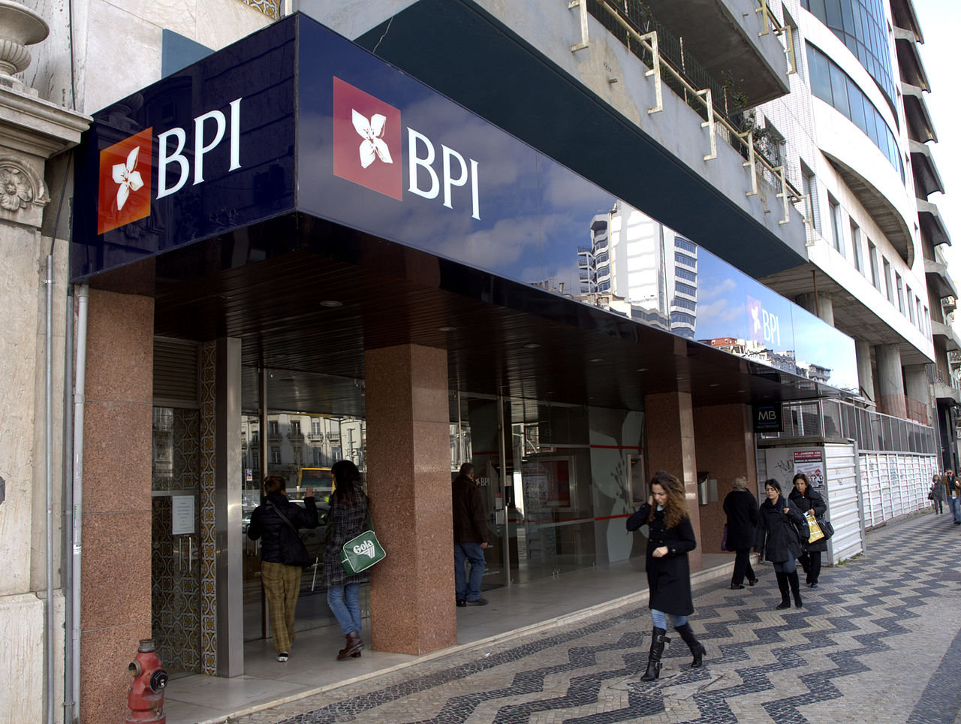
Problem Statement:
A Portuguese bank wants their customers to subscribe to their new term deposits. Results for previous phone marketing campaign has been provided to the manager who must
make the next marketing campaign more effective.
Challenges of Manager:
Customer complaints about irrelevant product calls.
No prior framework to choose which customer to target.
Objectives:
How to predict whether a customer will subscribe to a
term deposit or not?
Which determinants would indicate a customer is ready
to subscribe to a term deposit through direct marketing?
How to segment term deposit market?

Slide 3





Data Set Source:
http://archive.ics.uci.edu/ml/datasets/Bank+Marketing
Age
education
Job
default
Marital
housing
loan
contact
campaign
pdays
previous
poutcome
month
Day of week
duration
emp.var.rate
cons.price.idx
cons.conf.idx
euribor3m
nr.employed
Output variable y (desired target)
Rows | Columns
41,188 | 21
Missing Values: None

Slide 4
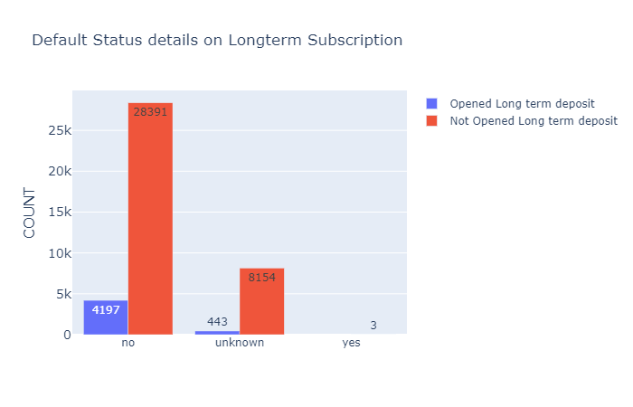
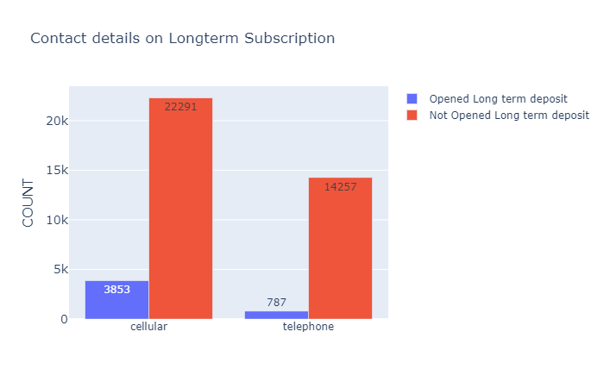
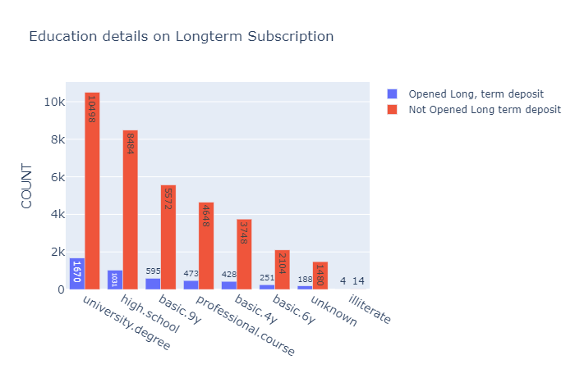
Exploratory Data Analysis
Lesser the default, better is the term deposit subscription.
Customers contacted through cellular has higher subscription rate.
Education is a key factor to predict the term deposit subscription. More the university degree of customer, better is their term deposit subscription.

Slide 5
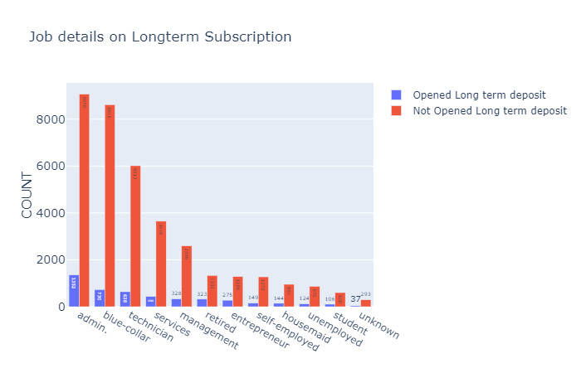
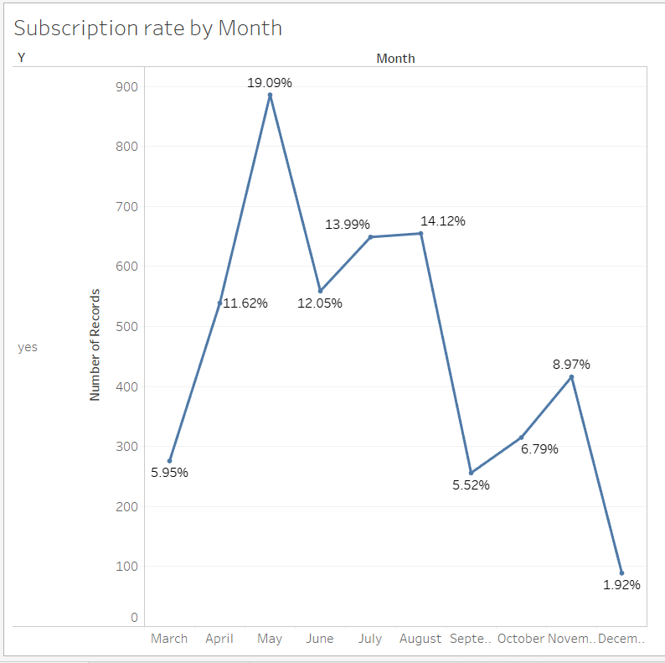
Though high in numbers, subscription rate of employees is very less.
We can see that the retired and management customers tend to subscribe term deposits more.
The month of May nearly has the highest number of customers subscribing

Slide 6
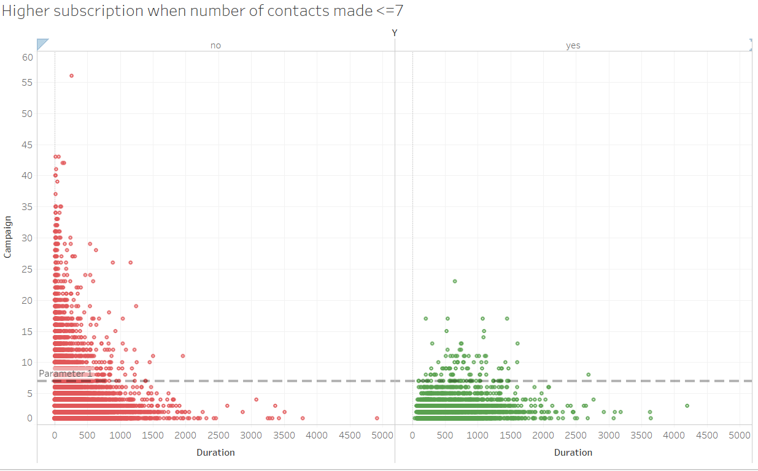
Subscription Rate based on contacts made
The number of calls is a key factor for the probability of opening the term deposit.
If the customer receives more than 7+ calls, the subscription rate is low.

Slide 7
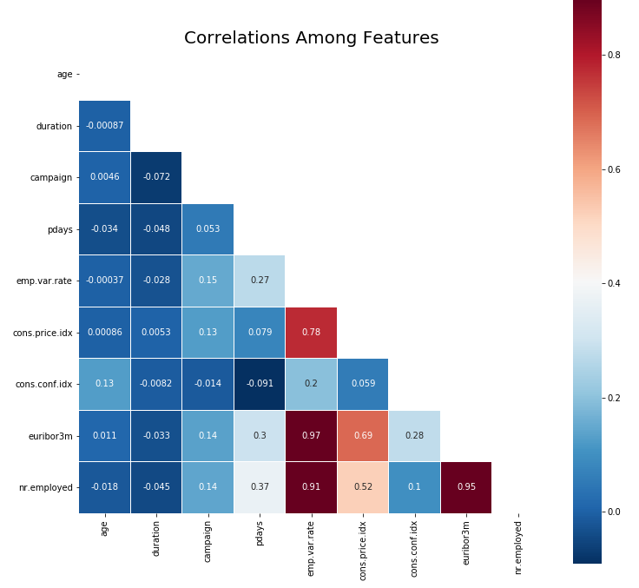
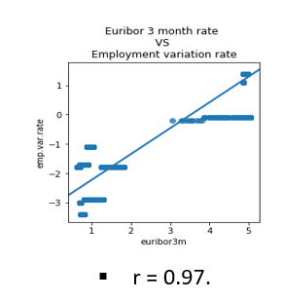
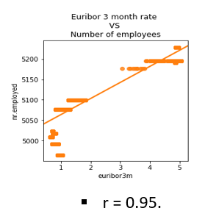
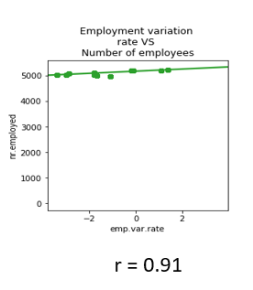
Emp.var.rate, nr.employed, euribor3m,cons.price.idx have high correlation among each other.
The above plot shows high correlation. So, higher the correlation more accuracy

Slide 8
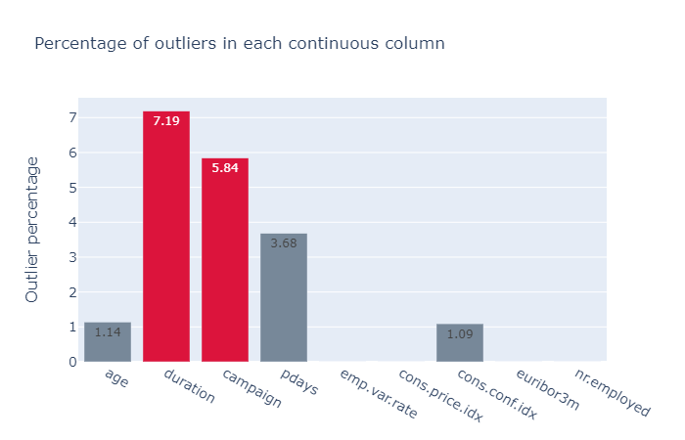
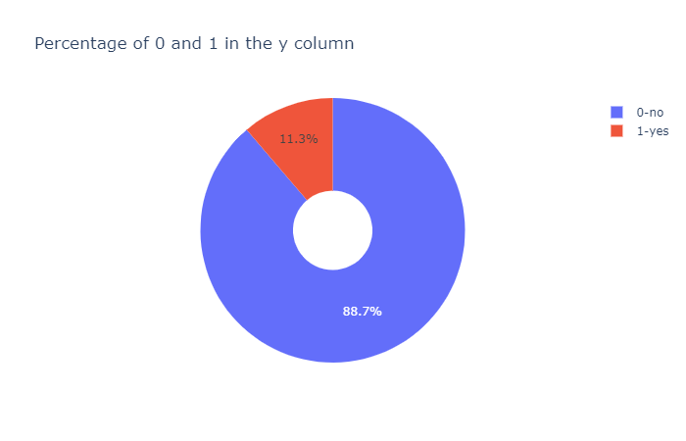
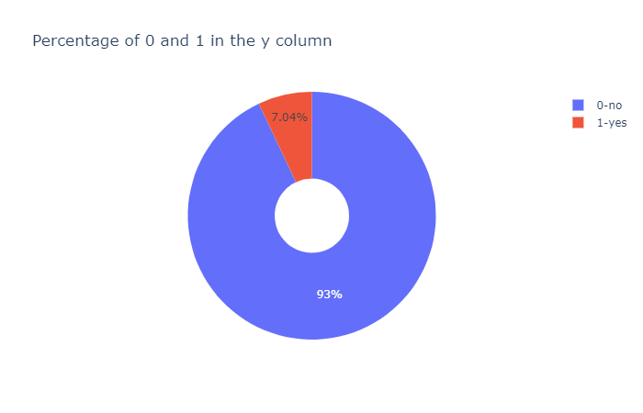
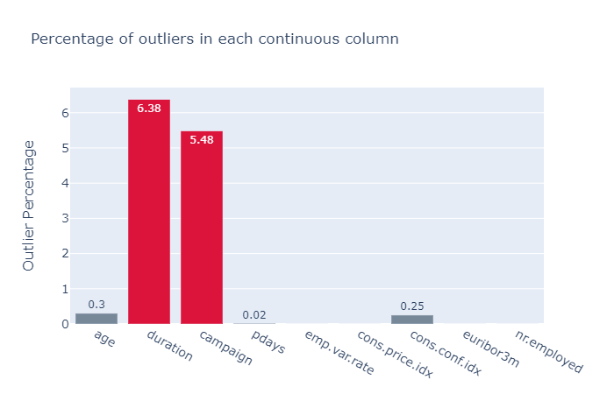
Before Outlier Removal:
After Outlier Removal using Isolation Forest:

Slide 9

Data Pre-processing
Removed outliers using Isolation Forest method.
Statistical significance Test performed.
getdummies is used for categorical columns.
Scaled data for Machine Learning models.
Checked for Dataset Balance(Target)
Without balancing the target, computed the Machine Learning models.
Balancing is done using SMOTE and oversampling, and then computed the Machine Learning models.

Slide 10
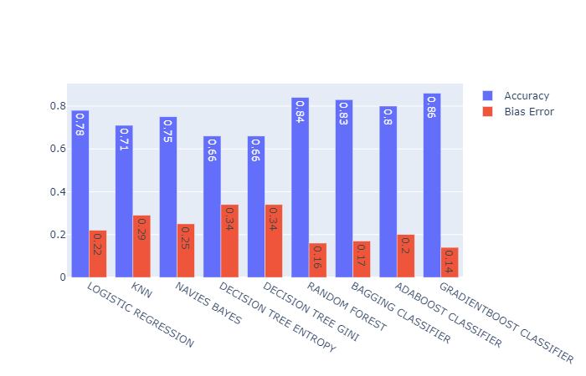
EVALUATION METRICS FROM TRAIN TEST SPLIT (70/30)
NAME | ACCURACY_TRAIN | ACCURACY_TEST | PRECISION | RECALL | ROC_AUC | F1-SCORE
LOGISTIC REGRESSION | 0.93 | 0.93 | 0.53 | 0.21 | 0.60 | 0.30
KNN | 0.94 | 0.93 | 0.49 | 0.18 | 0.58 | 0.26
NAVIES BAYES | 0.09 | 0.08 | 0.07 | 1.00 | 0.51 | 0.13
DECISION TREE ENTROPY | 1 | 0.92 | 0.40 | 0.43 | 0.69 | 0.42
DECISION TREE GINI | 1 | 0.92 | 0.40 | 0.45 | 0.70 | 0.43
RANDOM FOREST | 1 | 0.94 | 0.60 | 0.31 | 0.65 | 0.41
BAGGING CLASSIFIER | 0.99 | 0.93 | 0.51 | 0.34 | 0.66 | 0.41
ADABOOST CLASSIFIER | 0.93 | 0.93 | 0.51 | 0.27 | 0.62 | 0.35
GRADIENTBOOST CLASSIFIER | 0.94 | 0.94 | 0.59 | 0.34 | 0.66 | 0.43
K FOLD CROSS VALIDATION (N=5) ACCURACY,BIAS AND VARIANCE

Slide 11
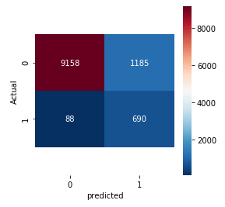
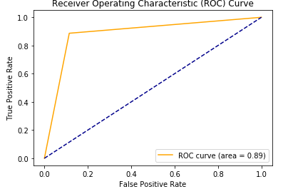
FINAL MODEL - LIGHT GBM:
CONFUSION MATRIX:
ROC_AUC CURVE:
EVALUATION METRICS:
ACCURACY = 0.88
PRECISION = 0.36
RECALL = 0.88
F1 SCORE = 0.52
ROC_AUC = 0.88

Slide 12
Project outcome:
Previous campaign data shows whether the customer subscribed to term deposits as a result of that campaign or not. Using this, we developed various Machine Learning models to predict whether customer will subscribe to term deposits or not.
Among all models, Light BGM gives the highest AUC and Recall scores when compared to other models.
When we implement this model to our new marketing campaign, it can efficiently target the interested customers and will be less bothering to uninterested customers.
Business outcome:
We used 10 Tele-marketing executives to call current customers and market our term deposit. Each person has a salary of 12 Euro/hr. Previous marketing campaign takes around 75 to 80 days to complete. So, the maximum cost for the bank in the time period is 76,800 Euros.
By using this model, we can target only the potential customers and can reduce the time spent on uninterested customers.

Slide 13
Thanks!

